Slide 1

INTRO TO NLP
Starting at 1905
https://forms.gle/YG9TtSbimF2bhiUR8
Attendance
Code inside the form
Some participants are allocated to Zoom due to limited capacity, first-come basis and LEARNOVA priority

Slide 2

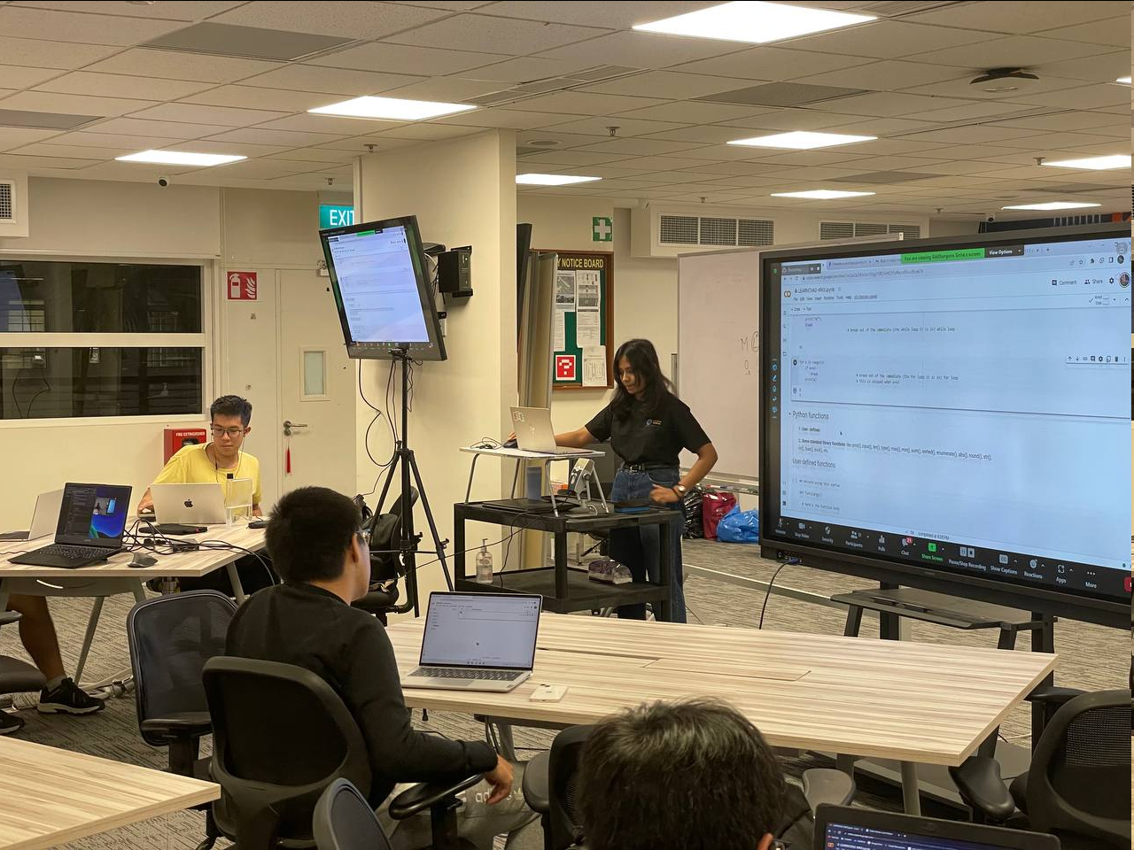

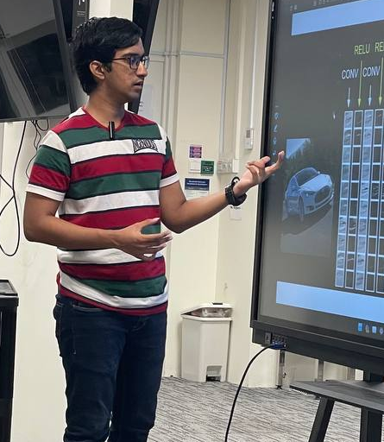
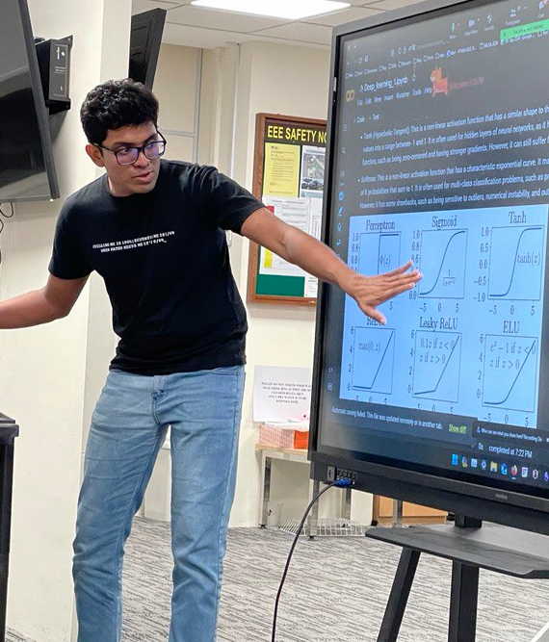

MLDA@EEE Academics Members

Slide 3
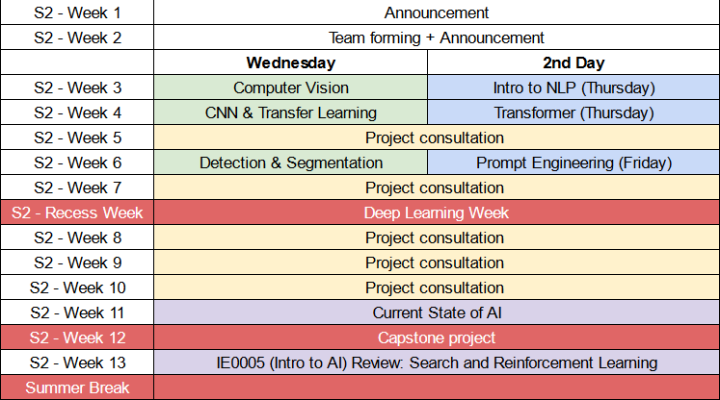
MLDA@EEE Academics LEARNOVA Plan

Slide 4
What is NLP
Understanding words
Represent words/language as numbers so we can perform matrix multiplication
Difficulties: ambiguities that make it difficult to accurately determines the intended meaning of text or voice data, due to sarcasm, idioms, metaphors, grammar and usage exceptions, variations in sentence structure

Slide 5
Basic deep learning recap
01
Perform matrix multiplication of data you have with variables(weights) to get an output (will be random at first)
02
Use loss function to find the “direction” (gradient) of change, or d(loss)/d(output)
03
Use the gradient, d(loss)/d(output) to find the change in weights to minimise the loss, or d(loss)/d(weights)

Slide 6
Training Process
X
f(X)
Input
ML Model f
Output
prediction
Update the weight
with Cost Function info
(gradient descent)
Compare by using
Cost/Loss Function
y
label
Objective: Minimise the loss
Or make Prediction as close to Label as possible

Slide 7
P(next word | prev words) = [1,12,3,123,]

Slide 8
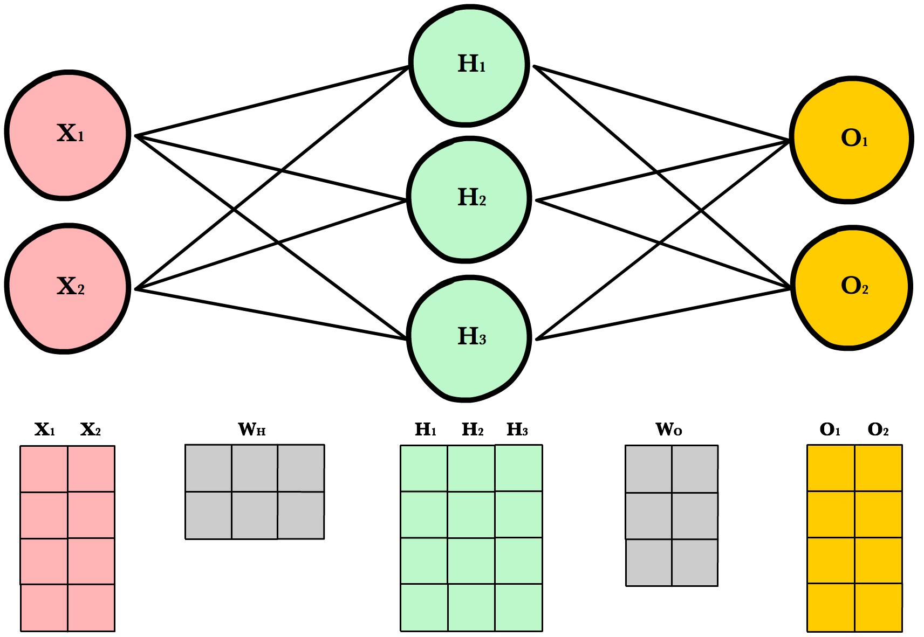
Matrix multiplication & the forward pass

Slide 9
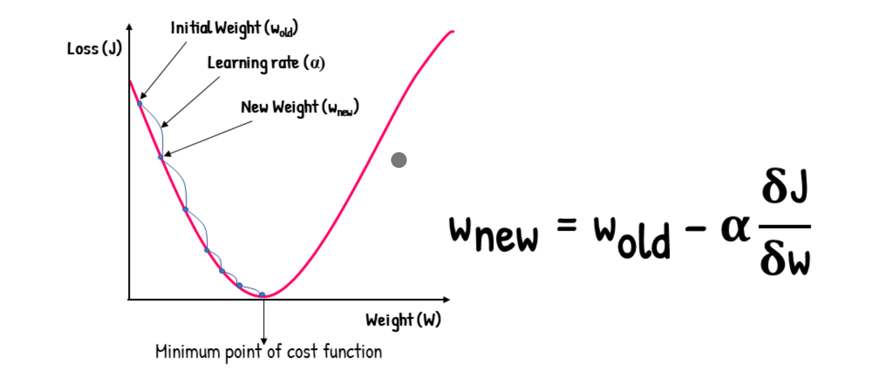
Backpropagation
output = input * weights + bias
loss(J) = label - output
dJ/dw = dJ/do * do/dw

Slide 10
Training Loop recap
Choose optimiser and Put model into training mode
Preprocess the data & zero optimiser
Forward pass
loss calculation & backward pass
optimiser step to update weights
calculate & print accuracy/loss

Slide 11
How to represent language with numbers?
Map each word to 1 number, keep a dictionary to remember which number is which word
Use a latent space of n-dimensions to represent a dictionary, where points are numbers
Eg. using x-y cartesian planes to store words. For example: “Technological“ may be (1.324234324, 0.3234496)
Give meaning to these axis? X-axis is feminine-masculine, y is tech-ness?
expand from x-y axis(2 dimensions) to multiple dimensions
openAI’s text-embedding-ada-002 has 1536 dimensions,

Slide 12
Let’s do number 1
Map each word to 1 letter, keep a dictionary to remember which number is which word
We will practise this in the context of text Classification
Refer to COLAB

Slide 13
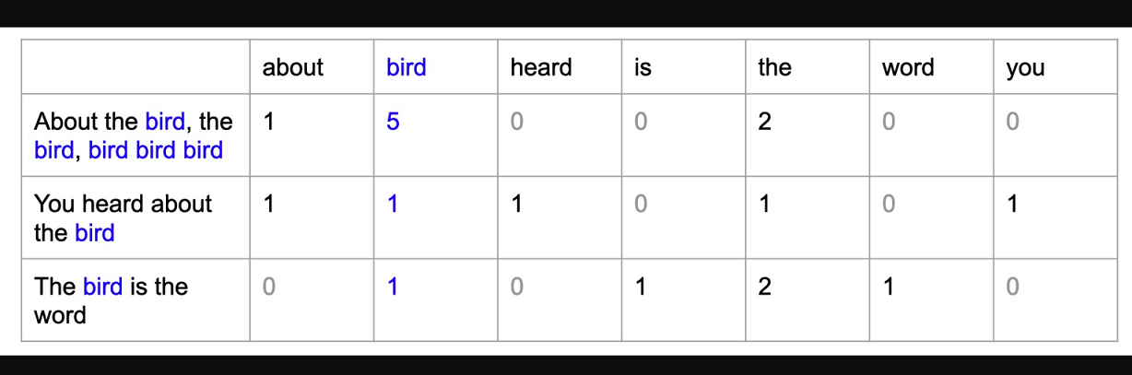

Slide 14
Number 1 recap
Map each word to 1 letter, keep a dictionary to remember which number is which word
Use BOW to keep track of number of occurrences of each word in a sentence
Use linear layers to find a pattern in number of occurrences of words & class of news
Possible qns:
Why do we use BOW and not just input the tokens into linear layers?

Slide 15
CBOW
I am running to school
I am jogging to school
I am walking to school
1 2 3 4 5
I am _____ to school

Slide 16
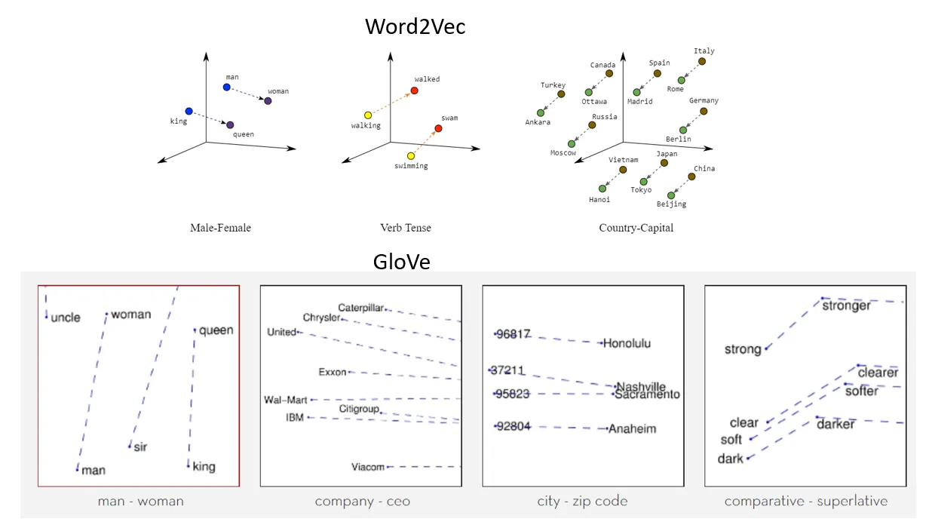

Slide 17
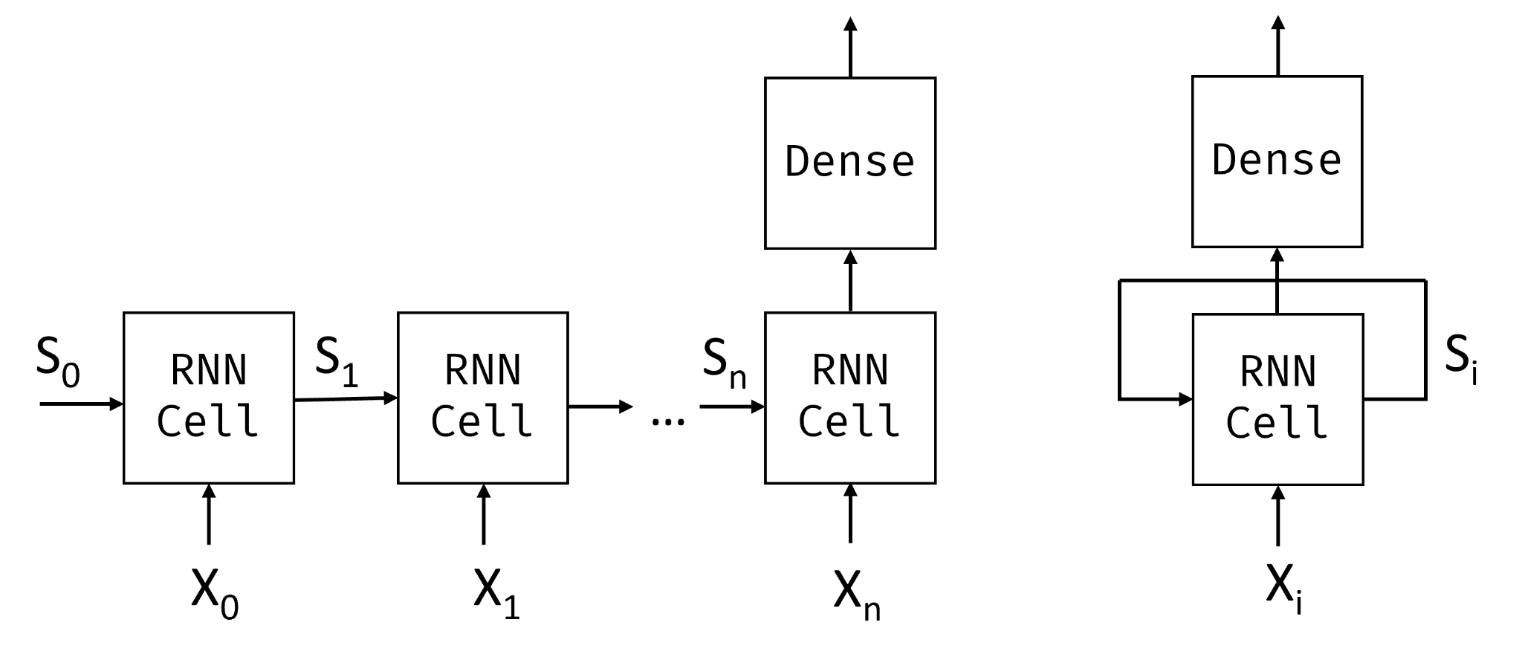

Slide 18
RNN
Linear layers
Linear layer, Sigmoid
Addition
Tanh
LSTMs store the cell state using a sophisticated system of gates that manage information flow, allowing the network to both retain important long-term information and discard irrelevant data.

Slide 19
“Meaning” of previous words plus word X1
Linear layer to learn how to classify/predict words based on final meaning
“Meaning” of previous word(s)
“Meaning” of whole sentence

Slide 20
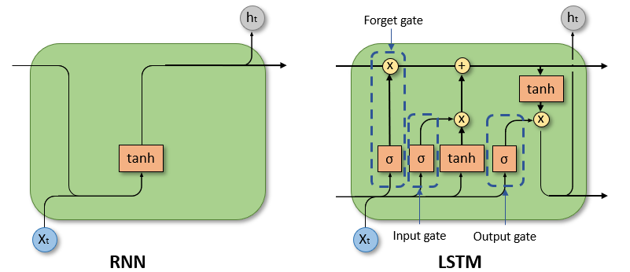
LSTMs store the cell state using a sophisticated system of gates that manage information flow, allowing the network to both retain important long-term information and discard irrelevant data.

Slide 21



Intro to NLP QR Codes
https://colab.research.google.com/drive/1Zo3P3zuGbRmfFAtHs-P-u7Wbz65ebr7i
COLAB NOTEBOOK
https://forms.gle/mAU3w8hKhjwvNUyF8
REVISION QUIZ
(no deadline)
https://forms.gle/XkWqLa1nsA7NY1XW6
FEEDBACK

